Slide 1
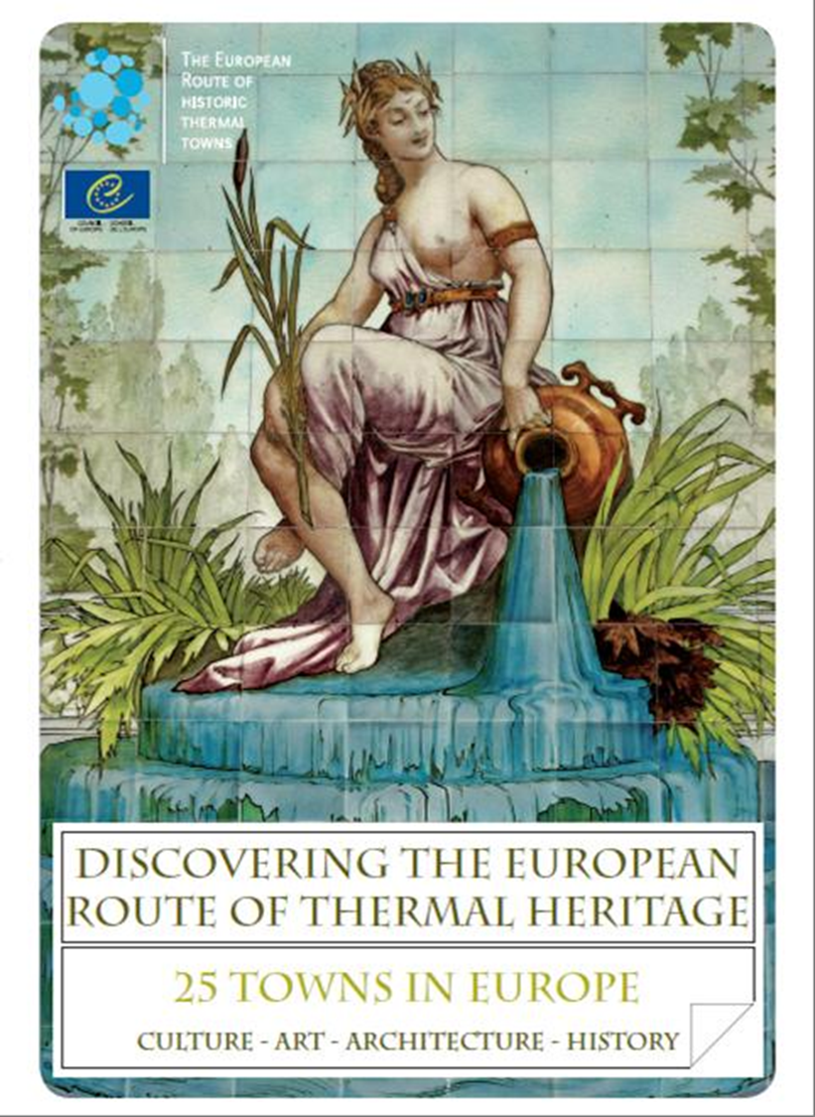
European Route of Historic Thermal Towns EHTTA
Café of Europe
Musical creation
in Thermal Towns
17 April 2014

Slide 2
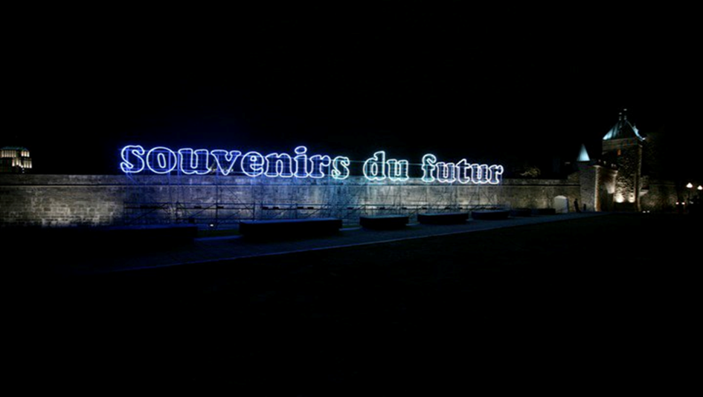

Slide 3
Characters in search of authors
The case of Thermal Towns
Europe should become a narrative continent which shows its common heritage, history and memory, using the close links between reality and imaginary

Slide 4
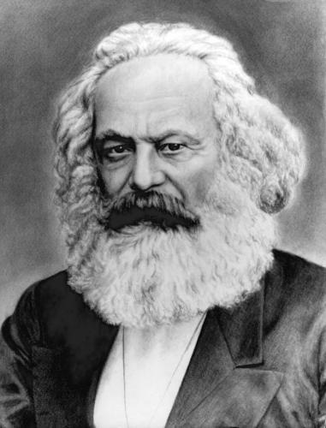
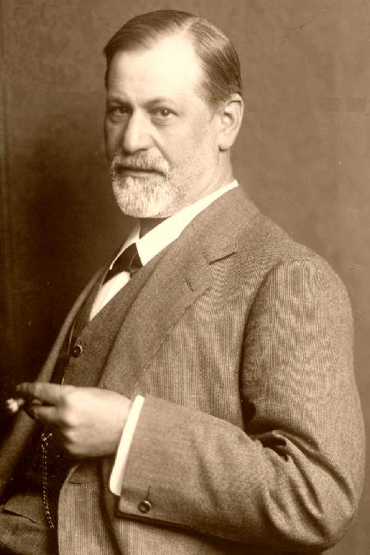
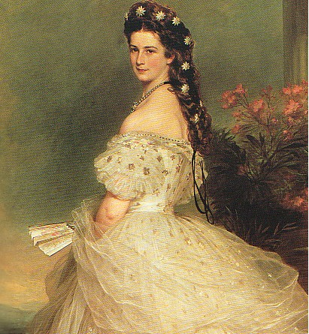

Slide 5
